Slide 1
Web API Development with ASP.NET Core (.NET 10)
DRDO October 2026

Slide 2
API
Ishaan Malik

Slide 3
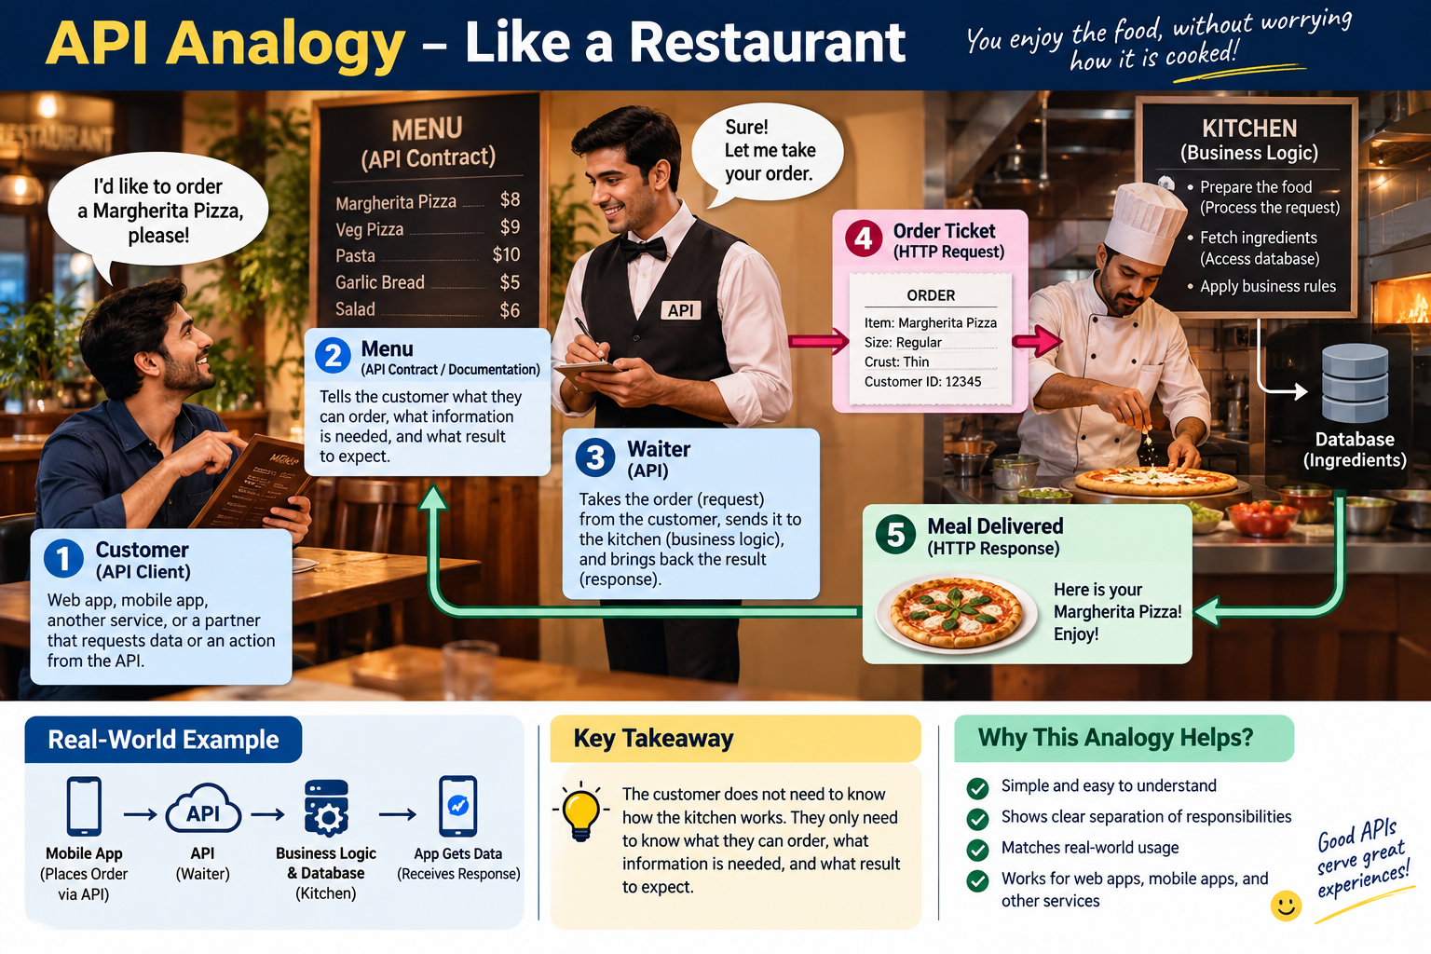

Slide 4
API = Application Programming Interface
An API stands for Application Programming Interface, which is a set of rules and protocols that lets different software applications communicate with each other.
In simple terms, it is a defined way for one software program to ask another software program for information (data) or tell it to do something (create, update or delete).

Slide 5
Advantages and Disadvantages
Advantages | Disadvantages
Connects completely different systems seamlessly (e.g., a phone app talking to a database). Automates manual tasks by letting computers update and sync data instantly. Saves development time by letting you plug into existing services (like Google Maps). Cuts costs by sharing resources across web, mobile, and desktop apps. | Completely reliant on internet connectivity to function. Requires ongoing maintenance as software and features change. Introduces security risks if the connection point is not heavily protected. Can become expensive if you rely heavily on paid third-party APIs.

Slide 6
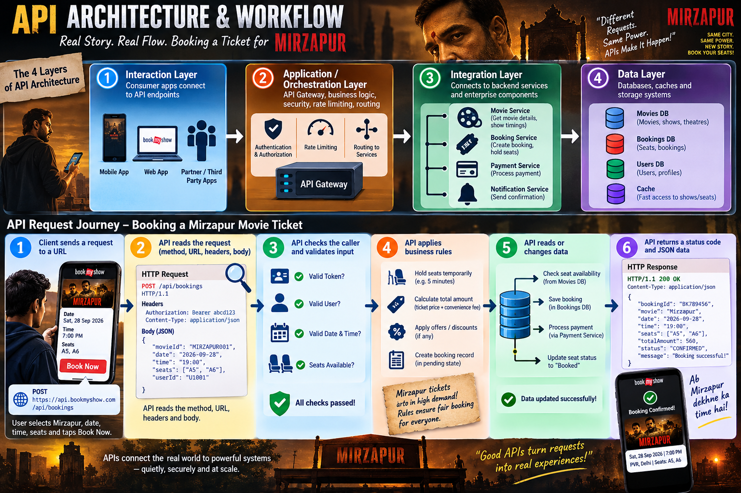

Slide 7
API Architecture
It is the structural blueprint and set of rules that defines how an API is designed, built, and operated.
It establishes how different software applications interact, what protocols they use, how data is formatted, and how security and performance are maintained across components.

Slide 8
4 Layers of API Architecture
Interaction Layer: The outward-facing boundary where consumer apps (web, mobile, third-party clients) connect to endpoints.
Application (or Orchestration) Layer: Houses the business logic, API gateways, routing mechanisms, and access control/rate-limiting protocols.
Integration Layer: Connects the API rules to internal backend microservices, functions, and enterprise components.
Data Layer: Manages underlying databases, caches, and storage systems to retrieve and save information securely.

Slide 9
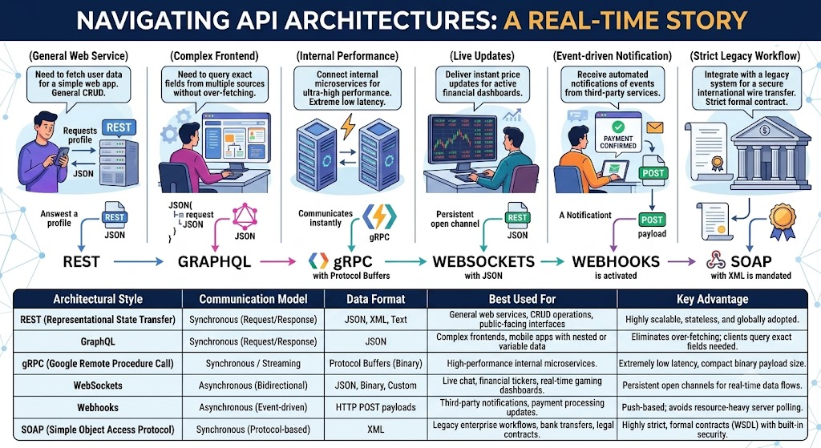

Slide 10
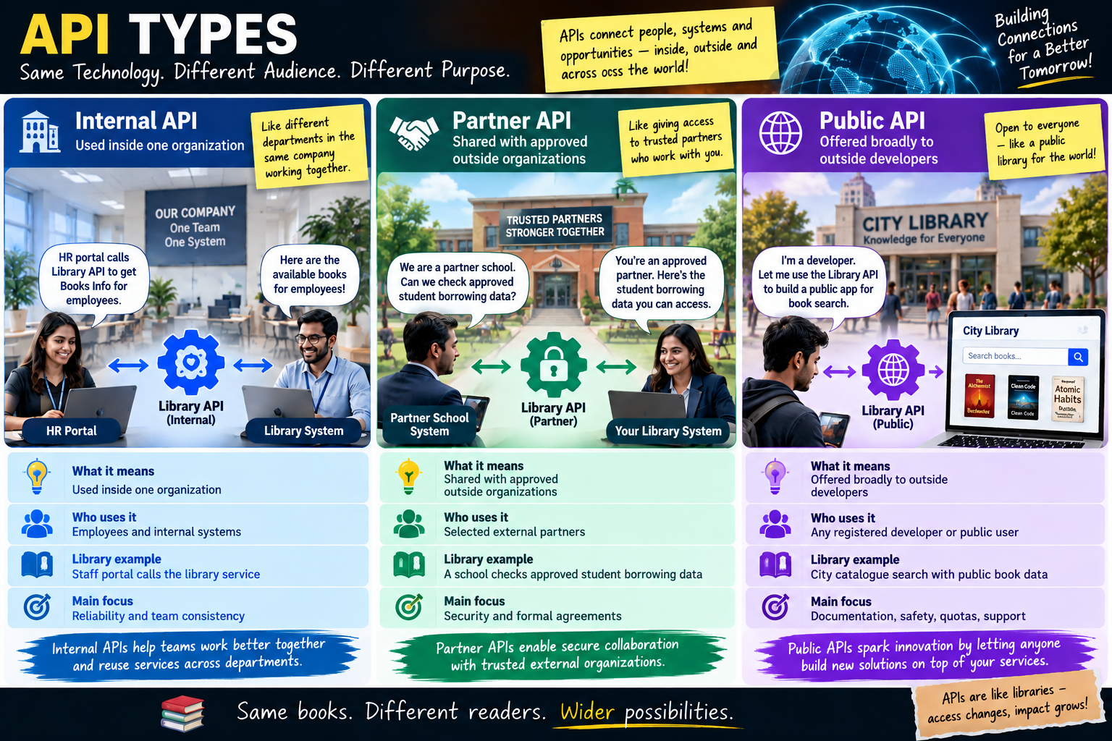

Slide 11
Quick Quiz
Which statement best describes an API contract?
A database backup file
An agreement describing how software communicates
A Docker image
A UI color guide
Answer: B

Slide 12
Quick Quiz
Who can be a consumer of an API?
Only browsers
Only mobile apps
Web apps, mobile apps, services and partners
Only SQL Server
Answer: C

Slide 13
Quick Quiz
Which API type is usually limited to approved external organizations?
A. Internal
B. Partner
C. Public
D. Localhost
Answer: B

Slide 14
What is HTTP?
HTTP is the communication mechanism used by browsers, apps, and APIs on the web.
Representational State Transfer (REST) is an architectural style commonly used with HTTP.
REST APIs are built on top of HTTP.
It tells us how requests are sent and how responses are returned.

Slide 15
HTTP Request
A request has four parts. Think of a courier parcel.
Part | Meaning | Example
Method | Action client wants to perform | GET, POST, PUT, DELETE
URL | API address to call | /api/students/1
Headers | Extra request information | Content-Type: application/json
Body | Data sent to API | JSON for a new student
Query string | Optional filtering/search data | ?name=ishan
E.g.
POST https://localhost:5001/api/students
Content-Type: application/json
Accept: application/json
{
"name": "Amit",
"email": "amit@test.com"
}

Slide 16
HTTP Response
After the API receives and processes a request, it sends an HTTP response.
Part | Meaning | Example
Status code | Result of request | 200, 201, 404
Response headers | Extra response information | Content-Type, Location
Response body | Returned data/error details | JSON object/array
HTTP/1.1 200 OK
Content-Type: application/json
{
"id": 1,
"name": "Amit",
"email": "amit@test.com"
}

Slide 17
HTTP Methods
HTTP methods tell the API what action wants to perform.
Method | What It Does | Request Body? | Response Code
GET | Read data | No | 200 OK or 404 Not Found
POST | Create a brand-new resource. | Yes | 201 Created
PUT | Replace the entire existing resource. | Yes | 200 OK or 204 No Content
PATCH | Partially update specific fields of a resource. | Yes | 200 OK or 204 No Content
DELETE | Remove a resource. | No | 204 No Content or 404 Not Found

Slide 18
HTTP Status Codes
HTTP status codes tell the client what happened after the API processed the request.
They are 3-digit standardized numbers the server sends back so the client knows what happened.
Code | Meaning | Campus Bites moment
200 OK | Worked, here's your data | Menu fetched successfully
201 Created | New thing made successfully | An order was placed
204 No Content | Worked, nothing to send back | An order was cancelled
400 Bad Request | You sent something wrong | Ordering zero quantity of an item
404 Not Found | That thing doesn't exist | Menu item 99, which was never on the napkin
409 Conflict | Clashes with the current state | Trying to cancel an order that's already “Delivered”
500 Server Error | Something broke on our side | A bug in our code, not the caller's fault

Slide 19
Safety and Idempotency
An HTTP method is Safe if calling it does not change any data on the server or in the database (Read-Only).
An HTTP method is Idempotent if executing it multiple times with the same input produces the exact same end state on the server as calling it once.
Method | Safe? | Idempotent? | Why?
GET | Yes | Yes | Only reads data; database state never changes.
POST | No | No | Calling it 3 times creates 3 duplicate records in the database.
PUT | No | Yes | Overwrites the resource with the exact payload provided; repeating it keeps the exact same state.
PATCH | No | No (by spec)* | Modifies data; operations like { "op": "increment", "amount": 10 } change state every time.
DELETE | No | Yes | Deleting item #10 removes it. Deleting it again leaves it deleted (end state is the same).

Slide 20
Quick Quiz
Which address correctly follows resource-naming rules for “get vada pav, item 2”?
/getMenuItem?id=2
/menu-items/2
/MenuItem/2
/menu-item/getById/2
Answer: B

Slide 21
Quick Quiz
A new student was successfully added. Which status is most suitable?
200 only, in every case
503 Service Unavailable
404 Not Found
201 Created
Answer: D

Slide 22
Quick Quiz
What does /orders/5/items represent?
The items belonging to order 5
Order number 5, repeated 5 times
Item number 5 in every order
A typo for /order-items/5
Answer: A

Slide 23
Quick Quiz
What goes wrong if an API always returns 200, even on failure?
Nothing, it's a style choice
The response gets bigger
Caching, monitoring, and automatic retries all quietly break
JSON stops working
Answer: C

Slide 24
REST Constraints
REST has a few rules called constraints that help us build APIs that are easy to understand and consistent.
REST has six constraints:
client-server,
stateless,
cacheable,
uniform interface,
layered system,
code-on-demand (optional)

Slide 25
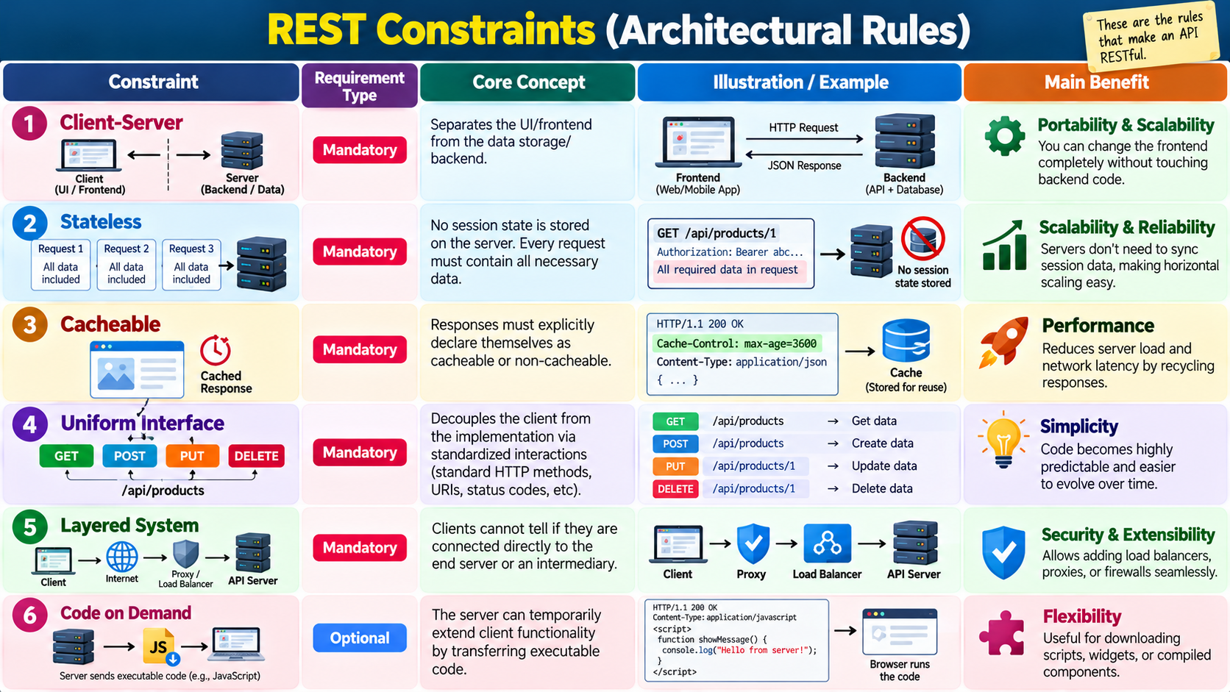

Slide 26
Quick Quiz
Which of the following best describes the Stateless constraint in a RESTful architecture?
The client is forbidden from maintaining any of its own application state locally.
The server must store session information in a distributed cache so multiple instances can access it.
Each request from a client to a server must contain all the information necessary to understand and complete the request, without relying on stored session context on the server.
The server and client must maintain an active, bidirectional persistent socket connection throughout the session lifecycle.
Answer: C

Slide 27
Quick Quiz
How do cacheable responses improve the efficiency of a RESTful web service?
By forcing the server to store a persistent copy of every client request indefinitely in RAM.
By encrypting the data payload twice to prevent unauthorized intermediate caching.
By ensuring that no response can ever be saved in an intermediate proxy or browser cache.
By labeling responses implicitly or explicitly as cacheable, clients can reuse response data for subsequent equivalent requests, reducing network traffic and server load.
Answer: D

Slide 28
Quick Quiz
Which of the following best characterizes the Layered System constraint in a REST architecture?
A client can only communicate with the ultimate end-server and is strictly forbidden from talking to any intermediary.
A component cannot see beyond the immediate layer it is interacting with, meaning a client cannot tell whether it is connected directly to the end server or an intermediary.
The database layer must be directly exposed to the client to minimize response latency.
All network layers from the physical OSI layer to the application layer must be combined into a single monolithic protocol.
Answer: B

Slide 29
Q&A
The End

